Slide 1

Exploratory Data Analysis
G2M Case Study
Virtual Internship – Ahmed Abubekr Elageib
Ahmedkata@Gmail.com
20-Jan-2023

Slide 2
Background –G2M(cab industry) case study
Case:
XYZ is a private equity firm in US. Due to remarkable growth in the Cab Industry in last few years and multiple key players in the market, it is planning for an investment in Cab industry.
Objective :
Provide actionable insights to help XYZ firm in identifying the right company for making investment.
The analysis has been divided into several parts:
Data Exploration
Price and Profit
Demand and Distribution
Trends and Seasonality
Investment Recommendation and Conclusion

Slide 3
Data Exploration
Data information:
Features: 24, including 9 derived features.
Timeframe: December 31, 2016, to December 31, 2018.
Data points: 355,032.
Assumptions:
Outliers are present in the price charged feature, but due to the unavailability of trip duration details, they are not being treated as outliers.
The profit of rides is calculated by keeping other factors constant and using only the price charged and cost of trip features.
The users feature of the city dataset is treated as the number of cab users in the city. It is assumed that this can also include other cab users, such as yellow and pink cabs.
Initial hypothesis questions:
Is there any seasonality in number of customers using the cab service?
Is there a sales difference between companies?
Is there a difference in sales between the cities?
Is there a difference in sales between the years?
Is there a certain age group that uses the cab service more than others?
Cab_Data.csv
Customer_ID.csv
Transaction_ID.csv
City.csv

Slide 4
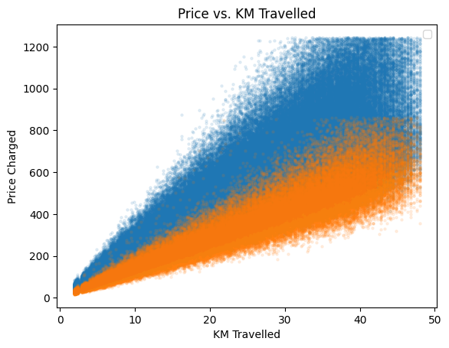
Profit Analysis
Price and Profit
This scatter plot shows the relationship between the price charged and the distance traveled for both Yellow Cab and Pink Cab. Here are some key observations:
The price generally increases with the distance traveled for both companies. This is expected, as longer trips typically incur higher costs for drivers.
Yellow Cab charges more per kilometer traveled compared to Pink Cab. This suggests that Yellow Cab may have a different pricing strategy or target a different customer segment than Pink Cab.
There is a wider range of prices for Yellow Cab compared to Pink Cab. This could be due to factors such as different car types, routes, or demand fluctuations.
Overall, this graph suggests that Yellow Cab charges higher prices than Pink Cab, but also covers a wider range of distances and potentially caters to customers willing to pay more for the service
Yellow Cab
Pink Cab

Slide 5
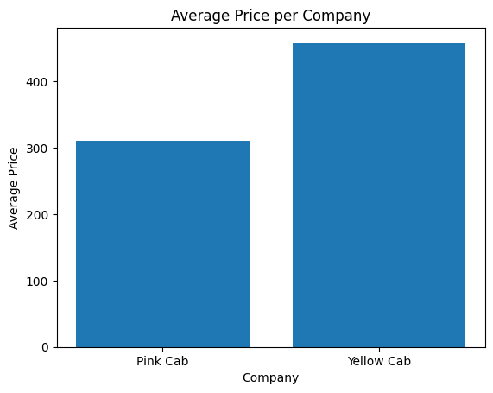
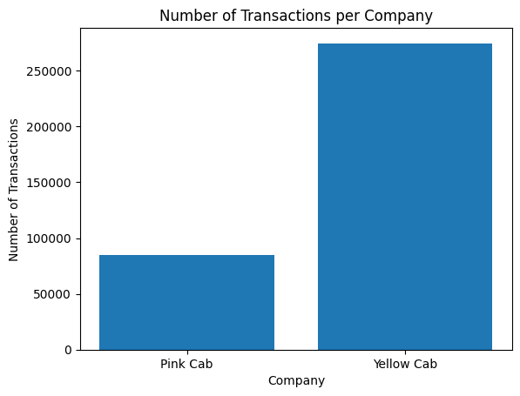
Profit Analysis
Price and Profit
Yellow Cab has a higher average price per transaction compared to Pink Cab. This confirms the findings from the previous slide that Yellow Cab generally charges more.
The difference in average price is around $30 USD, which is significant and could contribute to Yellow Cab's higher overall profits.
Both companies generally make more profit per kilometer as the distance traveled increases. This is likely because longer trips incur fewer fixed costs (e.g., driver pickup) and can be priced at a premium.
Yellow Cab consistently makes more profit per kilometer compared to Pink Cab. This suggests that Yellow Cab is more efficient at managing costs or has a more profitable pricing strategy, even after accounting for the higher fares they charge.
There is a wider spread of profit per kilometer for Yellow Cab compared to Pink Cab. This could indicate that Yellow Cab has a more variable cost structure or caters to a wider range of customers with different profit margins.
Overall, these graphs highlight Yellow Cab's advantage in terms of profit per kilometer traveled, which contributes to their overall higher profitability compared to Pink Cab.

Slide 6
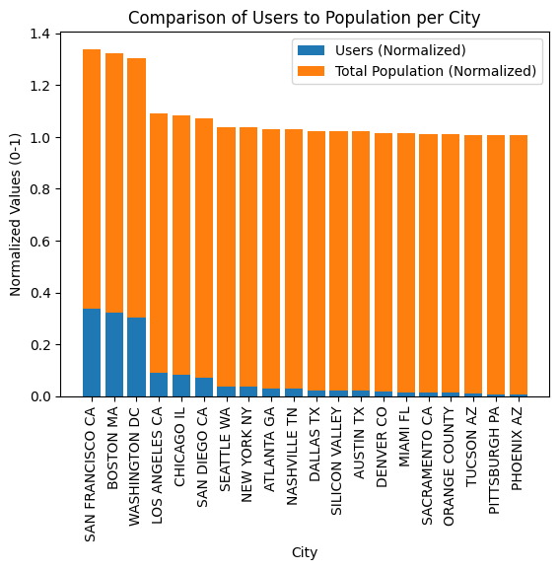
Profit Analysis
Demand and Distribution
This bar chart compares the normalized ratio of cab service users to the total population for each city. Here are the key observations:
The ratio of users to population varies significantly across different cities. This suggests that cab service usage patterns differ based on factors like demographics, infrastructure, and alternative transportation options.
Several cities have a user-to-population ratio above 0.1, indicating that a relatively high proportion of residents use cab services. These cities include San Francisco, Boston, Washington DC, and Los Angeles.
Yellow Cab generally has a higher user-to-population ratio compared to Pink Cab in most cities. This aligns with the previous finding that Yellow Cab has a wider customer base and higher transaction volume in most locations.
Interestingly, Pink Cab has a higher user-to-population ratio in a few cities, such as Seattle and Denver. This suggests that Pink Cab may be more effective at targeting specific demographics or catering to niche markets in certain areas.
Overall, this graph provides insights into the geographic distribution of cab service usage and highlights Yellow Cab's generally wider reach and customer base compared to Pink Cab. However, Pink Cab may have found success in targeting specific demographics or markets in certain cities.

Slide 7
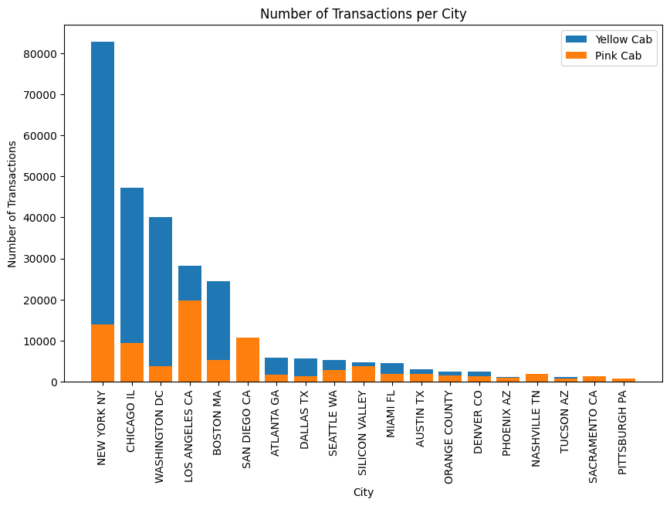
Profit Analysis
Demand and Distribution
This bar chart shows the number of transactions completed by Yellow Cab and Pink Cab in each major city. Here are the key observations:
Yellow Cab generally has a higher number of transactions than Pink Cab in most cities. This indicates that Yellow Cab has a wider reach and customer base compared to Pink Cab.
There are a few cities where Pink Cab has a higher number of transactions, such as San Diego and Miami. This suggests that Pink Cab may have a stronger presence or competitive advantage in certain markets.
The difference in transaction volume is particularly significant in large cities like New York, Chicago, and Los Angeles. This highlights Yellow Cab's dominance in major markets, which likely contributes to their overall higher profitability.
Overall, this graph suggests that Yellow Cab has a broader market reach and higher transaction volume compared to Pink Cab, especially in major cities. This wider customer base likely contributes to Yellow Cab's overall financial success.

Slide 8
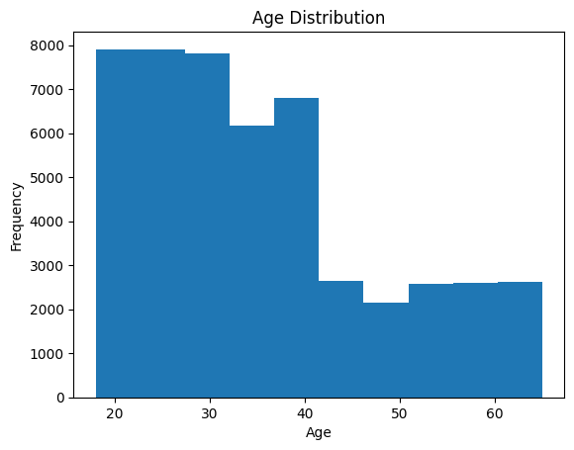
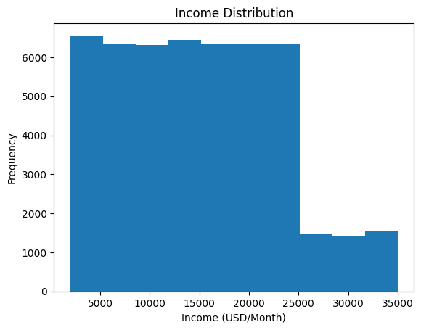
Profit Analysis
Demand and Distribution
This histogram shows the age distribution of users for both Yellow Cab and Pink Cab. Here are the key takeaways:
Both companies have a similar user base distribution, with the largest concentration in the 25-44 age group. This age group is typically more mobile and career-oriented, making them frequent users of transportation services.
There is a noticeable secondary peak in the 18-24 age group for both companies. This suggests that young adults also form a significant portion of the customer base, likely due to factors like social outings, limited car ownership, and reliance on convenient transportation options.
This chart shows the distribution of users across different income brackets for both Yellow Cab and Pink Cab. Here are the key observations:
Both companies have a larger concentration of users in the lower and middle-income brackets. This aligns with the expectation that cab services are often used by people who may not own a car or prefer not to drive themselves, which can be more common in lower-income groups.
Yellow Cab appears to have a slightly higher proportion of users in the higher income brackets compared to Pink Cab.
Both Yellow Cab and Pink Cab cater to a similar customer base in terms of age and income, with a focus on:
Young professionals and adults: The largest user concentration falls within the 25-44 age group, indicating frequent usage for work, social outings, or convenience.
Lower and middle-income brackets: A significant portion of users comes from these groups, suggesting reliance on cab services due to lack of car ownership or preference for alternative transportation.

Slide 9
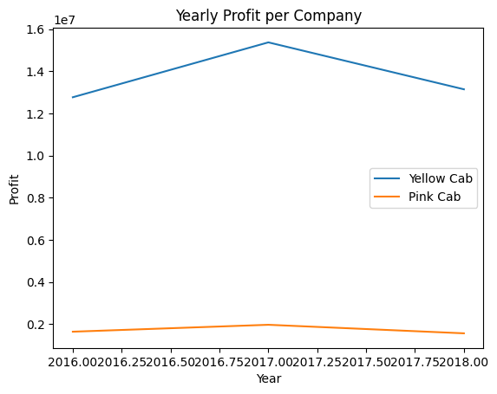
Profit Analysis
Trends and Seasonality
This line graph shows the yearly profit for both Yellow Cab and Pink Cab from 2016 to 2018. Here are the key observations:
Yellow Cab consistently has a higher annual profit than Pink Cab throughout the entire period. This confirms the findings from previous slides that Yellow Cab generally charges more, has a wider customer base, and potentially enjoys higher profit margins.
The gap in yearly profit between the two companies widens over time. This suggests that Yellow Cab is not only more profitable but also growing its profit at a faster rate compared to Pink Cab.
Both companies experience some fluctuations in profit from year to year. This could be due to seasonal variations in demand, economic factors, or changes in their pricing strategies. However, Yellow Cab appears to be more resilient to these fluctuations, maintaining a consistently higher profit level.
Overall, this graph clearly demonstrates Yellow Cab's dominance in terms of yearly profitability. Their consistent lead and increasing profit gap highlight their strong financial performance compared to Pink Cab.

Slide 10
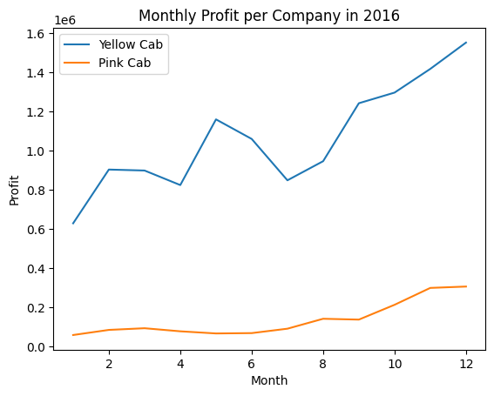
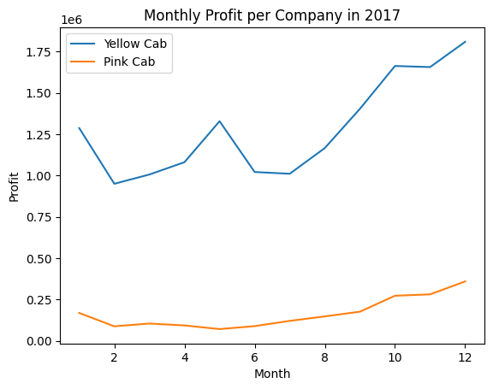
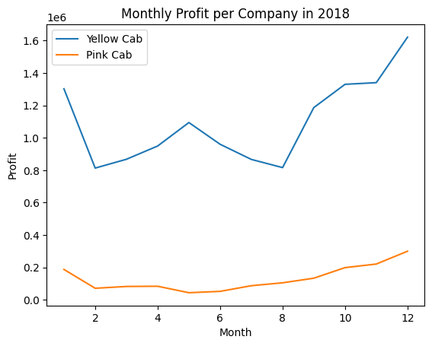
Profit Analysis
Trends and Seasonality
While both Yellow Cab and Pink Cab experience seasonal fluctuations in monthly profit, Yellow Cab demonstrates a stronger overall financial performance and consistent profitability throughout the years.
Yellow Cab consistently outperforms Pink Cab in monthly profit across all three years. This indicates a wider customer base, potentially higher fares, or better cost management for Yellow Cab.
Both companies exhibit similar seasonal patterns, with peaks in profitability during summer months (June-August) and dips in winter (December-February). This aligns with expectations of higher travel demand during warmer seasons and holidays.
Yellow Cab generally exhibits a faster recovery from profit dips, suggesting better resilience to seasonal fluctuations or more effective pricing strategies during low-demand periods.
In 2018, the gap between Yellow Cab and Pink Cab's monthly profits widens significantly. This further strengthens the evidence of Yellow Cab's growing financial lead.
Overall, considering the consistent lead in monthly and yearly profits, wider customer reach, and faster recovery during low seasons, Yellow Cab appears to be the more profitable company with a stronger financial position. However, it's important to acknowledge that these graphs only represent a limited timeframe and don't account for other factors that could influence investment decisions.

Slide 11
Profit Analysis
Investment Recommendation and Conclusion
Based on the comprehensive analysis of various data visualizations, including price comparisons, demand distribution, profit trends, user demographics, and income brackets, I recommend investing in Yellow Cab. Here's a summary of the key findings supporting this recommendation:
Financial Performance:
Consistently higher profits: Yellow Cab demonstrates a clear lead in both yearly and monthly profitability throughout the period analyzed.
Wider profit margin: Their pricing strategy and potentially better cost management lead to higher profit per kilometer traveled compared to Pink Cab.
Resilient to fluctuations: Yellow Cab exhibits faster recovery from seasonal dips and appears less susceptible to external factors impacting profitability.
Market Reach and Customer Base:
Dominant presence: Yellow Cab enjoys a wider reach in major cities and a larger overall customer base compared to Pink Cab.
Attracts diverse demographics: They cater to a broader range of users across different age groups and income levels, offering wider market appeal.
Potential for niche markets: While Yellow Cab caters to a wider audience, Pink Cab's success in specific cities suggests potential for niche market dominance.
Competitive Advantages:
Established brand recognition: Yellow Cab's longer history and wider presence contribute to stronger brand awareness and potentially attract more customers.
Adaptability to seasonality: Their pricing strategies seem effective in adjusting to seasonal demand fluctuations, leading to faster profit recovery during low seasons.
Potential for further growth: Yellow Cab's consistent financial lead and wider market reach position them well for future expansion and continued profitability.
While both companies have their strengths and weaknesses, Yellow Cab's overall financial performance, broader market reach, diverse customer base, and established brand suggest a stronger potential for future growth and higher returns on investment. However, it's essential to remember that this recommendation is based on the data analyzed and may not account for unforeseen circumstances or future market changes. Conducting further due diligence and considering factors like industry trends, operational efficiency, and brand reputation is crucial before making any final investment decisions.

Slide 12
Thank You

